Slide 1
Tectonics of Death Valley Region, California
Mason L. Hill & Bennie W. Troxel
James MCNeil

Slide 2
Introduction
Death Valley
Turtlebacks – Black Mountains
Three groups
Simple tensional stress
Simple compressional stress
Combined tensional and compressional stress
Features characterized by strike-slip vs dip-slip
This study
Suggest single tectonic strain system
NE-SW horizontal shortening
NW-SE relative extension
Could be related to larger SAF system

Slide 3
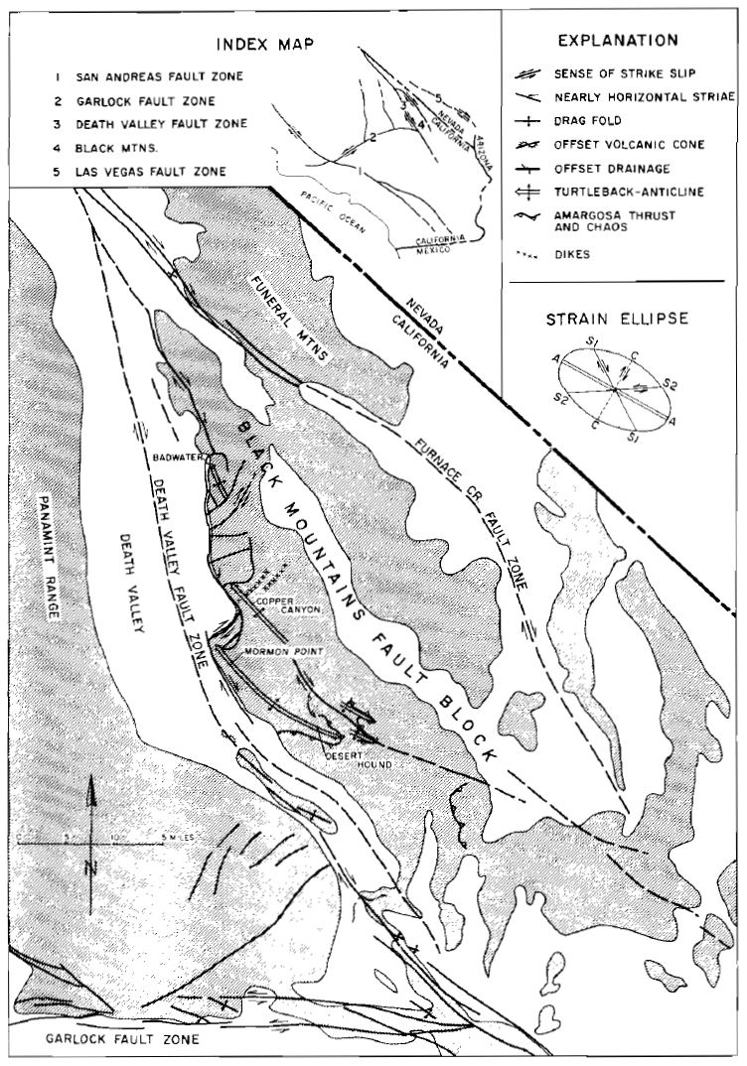
Tectonics
Subparallel strike-slip fault systems
Death Valley fault zone
Furnace Creek fault zone
Left-lateral Garlock Fault
Turtlebacks (NW plunging)
Badwater, Copper Canyon, Mormon Point
Exhumed surfaces of an unconformity
Precambrian crystalline rx. overlain by Tertiary seds
Evidence of right-lateral slip
Striations (plunging 30° northwest)
Drag folds
Right-lateral offset of a cinder cone
Right lateral offsets of drainage line
NE trending ‘gash’ faults and dikes
En echelon pattern of NW turtlebacks

Slide 4
Conclusions
Shortening structures – NE-SW shortening
Amargosa thrust & turtlebacks
Strike-slip system w/ strain axes approx. horizontal
Anomalies occurring in confined zone between D.V. and F.C. strike-slip fault zones
NE-SW shortening w/ folding, faulting, uplift, & erosion
Turtlebacks
Chaos
Eroded and tectonically thinned to missing Paleozoic section
Modifying B&R tectonics
Previous model of pure dip-slip
Using the D.V. strike-slip model for B&R systems
Potential role of strike-slip faulting late Tertiary to recent throughout the region

Slide 5
Late Cenozoic history and styles of deformation along the southern Death Valley fault zone, California
Paul Ray Butler, Bennie W. Troxel, & Kenneth L. VeroSUB
James MCNeil

Slide 6
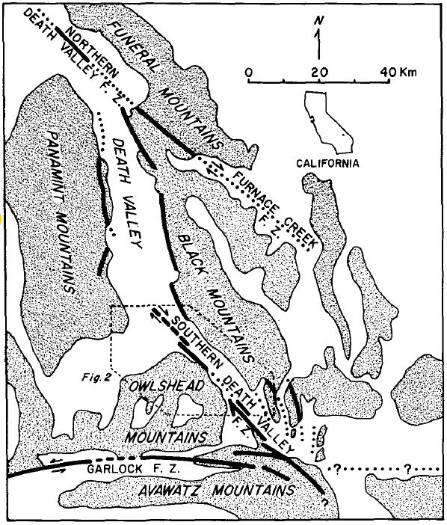
Introduction
Late Cenozoic deposits in southern Death Valley are offset ~35 km by right-lateral strike-slip faults beginning in the Miocene and before ~1 m.y.
Butler et al., 1988

Slide 7
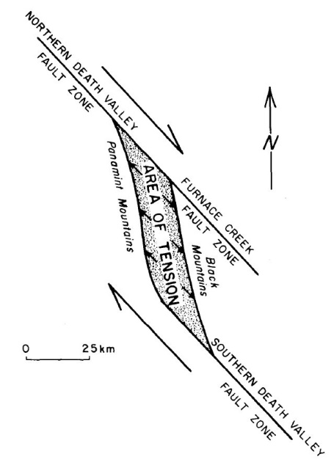
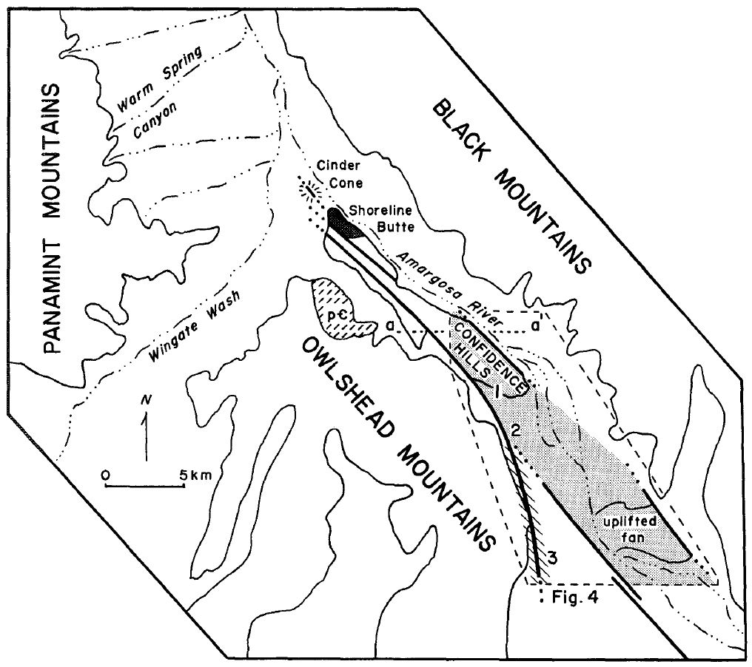
Background
Controversy over the amount of strike-slip movement in the southern Death Valley region
8 km (Wright and Troxel, 1967)
80 km (Stewart, 1967)
35 km (this study)
Eastern and western subzone
Western subzone along flank of Owlshead Mountains
Eastern subzone in southern Death Valley floor

Slide 8
Western Subzone
Older than eastern subzone
Evidence for ~35 km of right-lateral displacement along western subzone
Correlating alluvial fan gravels with source area to the NW
Uncertainty of the offset (±5 km)
Assumption that onset of volcanism is linked to fault movement
Initiation of strike-slip movement coeval with onset of Miocene volcanism
Little to no lateral displacement occurred in western subzone after ~1 m.y. (based on K-Ar dates from ash layers just below fan gravels)

Slide 9
Eastern Subzone
Younger than western subzone
Lateral and vertical components of movement
Split cinder cone (0.69 Ma) shows offset for eastern subzone
Confidence Hills
Lacustrine sequence overlain by alluvial gravels
Fan gravels uplifted up to 200 m above modern fan surface
Seds are compressed and folded parallel to faults
Uplifted Alluvial Fan
Adjacent to Amargosa River
Deformed by NW trending horsts and grabens (<5 m vertical displacements) and gentle folds
Uplifts related to localized shortening perpendicular to faults in eastern subzone including Confidence Hills and southern Death Valley fault zone near Avawatz Mountains

Slide 10
Summary & Conclusions
Region characterized by mid-Tertiary to Holocene extension
~35 km of right-lateral displacement along the southern Death Valley fault zone
Western subzone is older with greater displacements
Eastern subzone younger with more folding
Possible explanation related to Garlock fault
Intersection of southern D.V. fault and Garlock fault to south (~2 km)
Garlock show left-lateral displacement but eastern termination is debated
Eastward “ramping” since Miocene
Garlock fault zone has been active during the same time period as D.V. fault zone
East-directed thrusting of Avawatz Mountains
Likely responsible for most recent activity along southern D.V. fault zone
Avawatz Mountains thrust to east along branch of Garlock fault
Explains difference in age and style of deformation for eastern and western subzones

